Slide 1



Real-Time
Bicycle Theft
Detection
Multi-Stage AI: From Object Detection to Intent Analysis on Edge Hardware
Joshua Joffy Arakkal
December 3, 2025

Slide 2
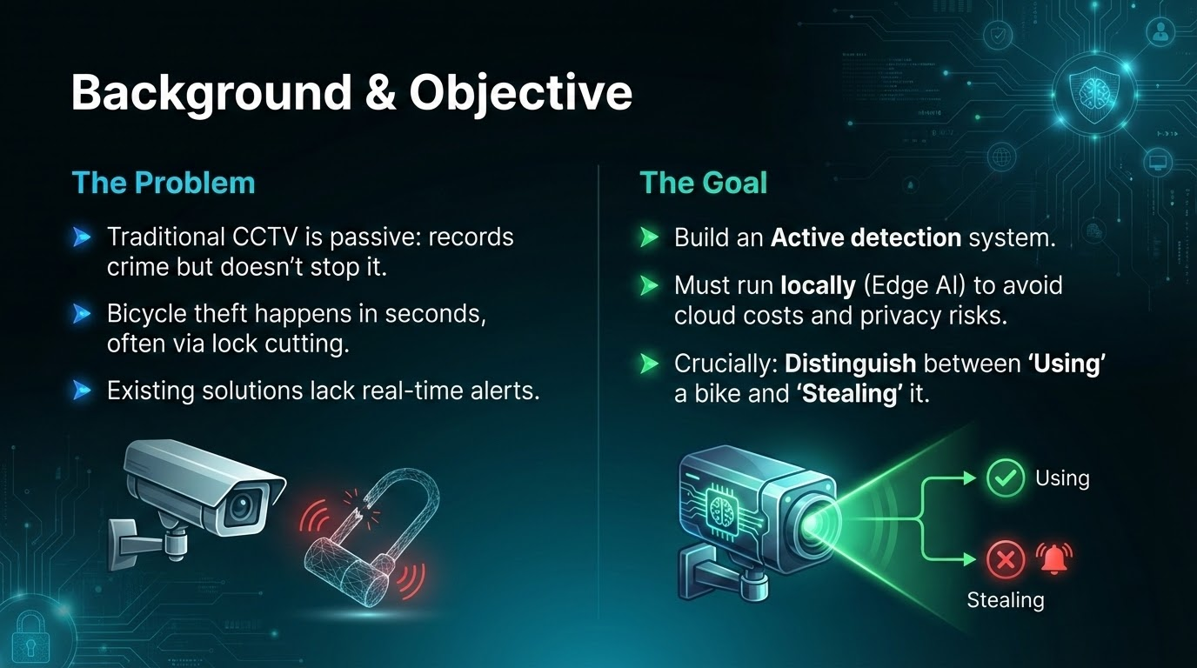

Slide 3
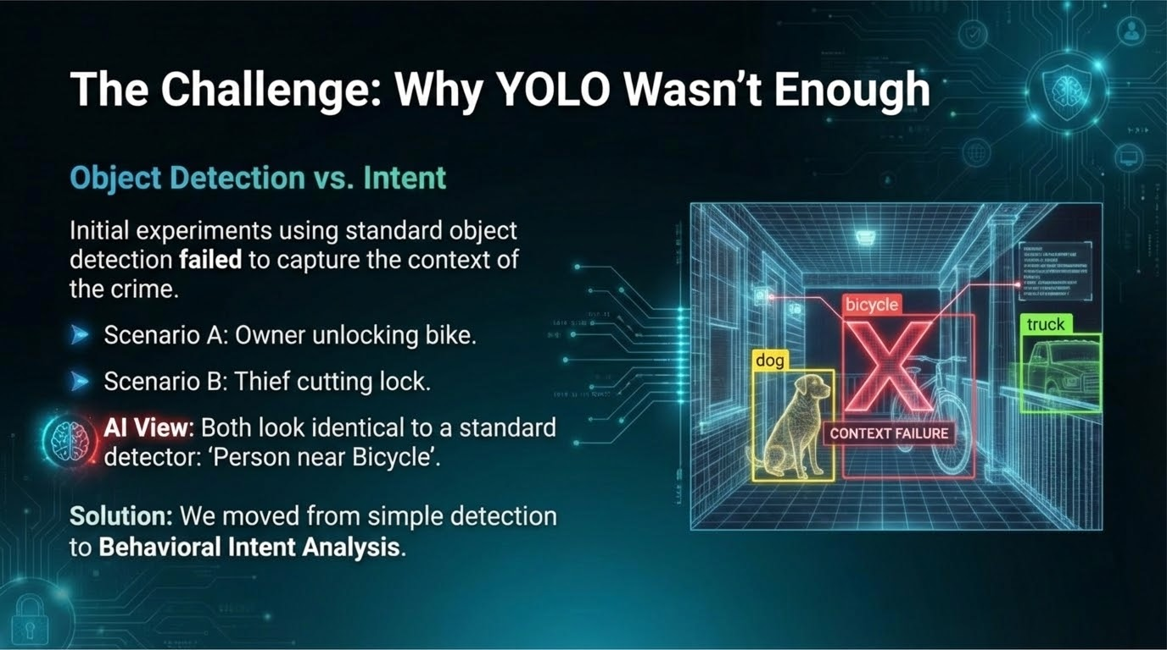

Slide 4
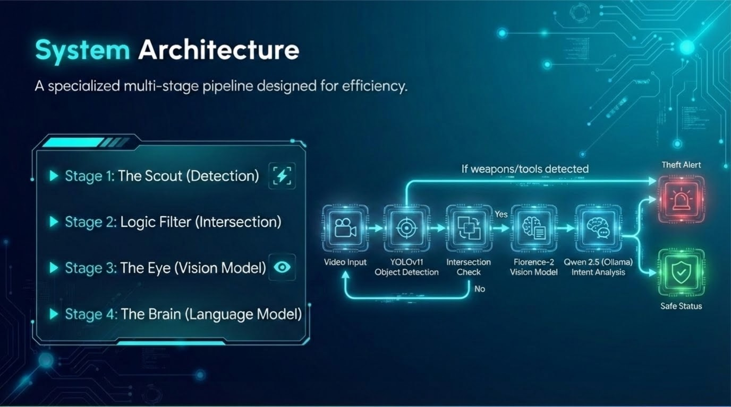

Slide 5
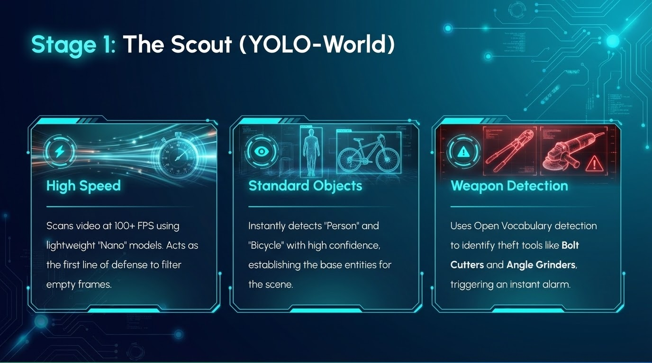

Slide 6
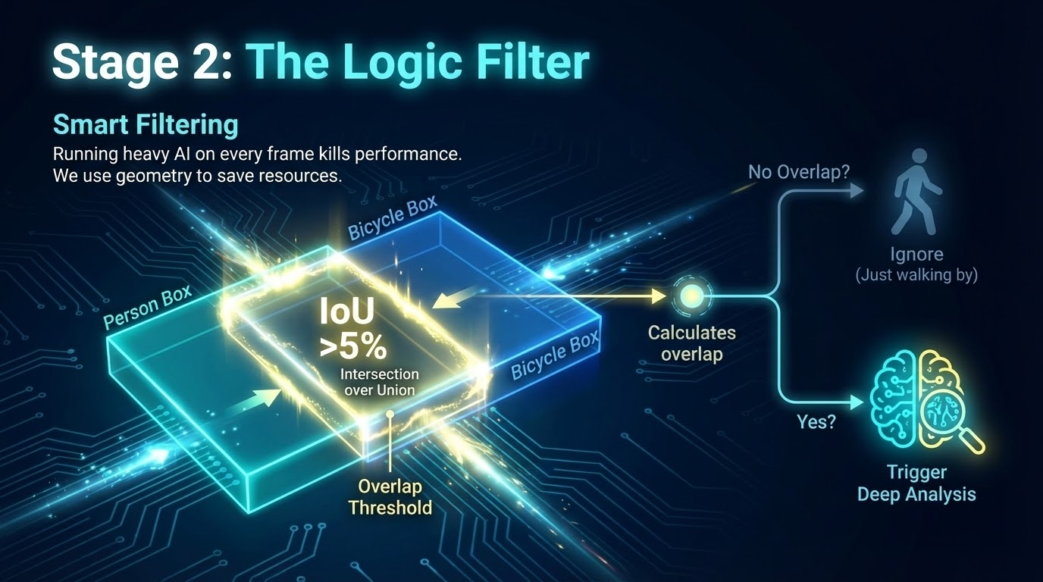

Slide 7
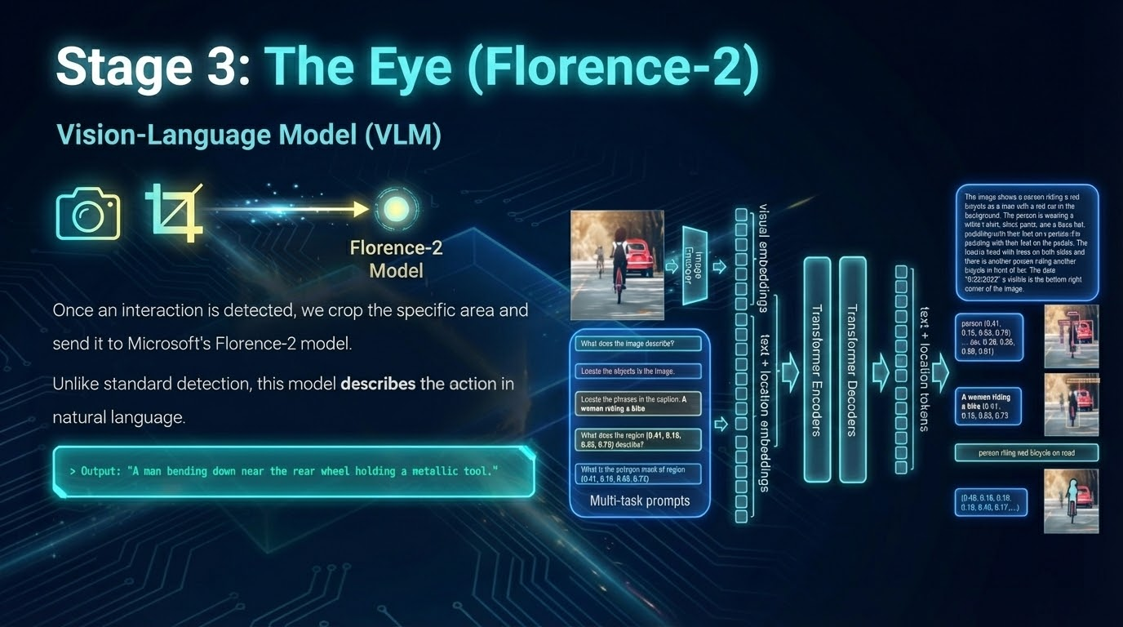

Slide 8
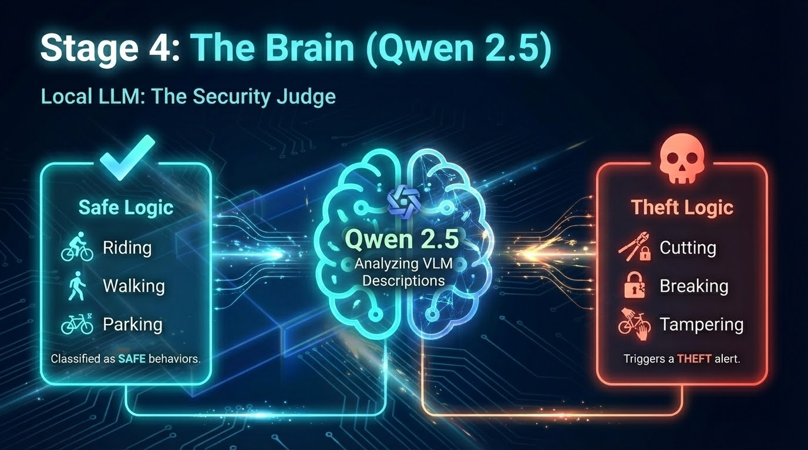

Slide 9
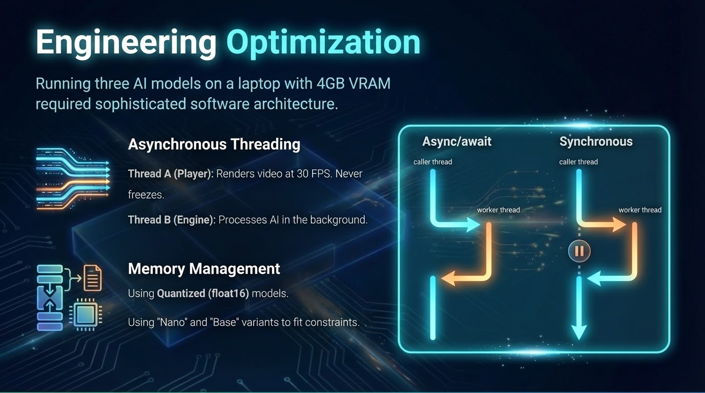

Slide 10


Slide 11
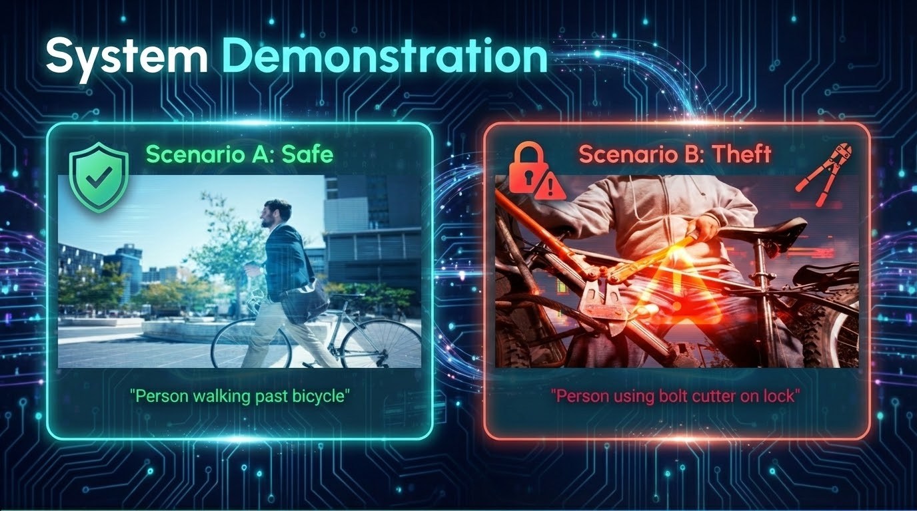

Slide 12
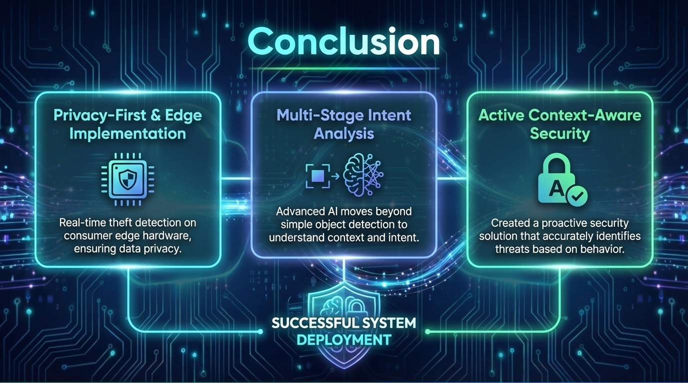

Slide 13








Image Sources / Reference
▹
https://sirixmonitoring.com/wp-content/uploads/2024/05/What-is-an-AI-surveillance-camera-1200x900.webp
Source: sirixmonitoring.com
▹
https://images.squarespace-cdn.com/content/v1/63d40fe2cbd65e16cb8098b6/1677619217385-Z95RQ90R4W9P15JTDW2R/object%2Bdetection.png
Source: www.inspiritai.com
▹
https://pub.mdpi-res.com/drones/drones-06-00410/article_deploy/html/images/drones-06-00410-g001.png?1680768884
Source: www.mdpi.com
▹
https://pubs.rsna.org/cms/10.1148/radiol.251458/asset/images/radiol.251458.va.jpg
Source: pubs.rsna.org
▹
https://pub.mdpi-res.com/algorithms/algorithms-18-00385/article_deploy/html/images/algorithms-18-00385-g001.png?1750852947
Source: www.mdpi.com
▹
https://media.istockphoto.com/id/1142860866/vector/abstract-tech-bg-with-lock-access-protection.jpg?s=612x612&w=0&k=20&c=yCNHKMSKxlgi8iuG2BTu9pyMuil8sDHe_Yf_bXi8zMQ=
Source: www.istockphoto.com
▹
https://tnstatic.net/attachments/upload_2022-5-15_18-1-8-jpg.740705/
Source: www.tundras.com

Slide 14


